Slide 1
What is low code?
And why do I care?

Slide 2

Stacey Levine – Senior Solutions Architect

Slide 3
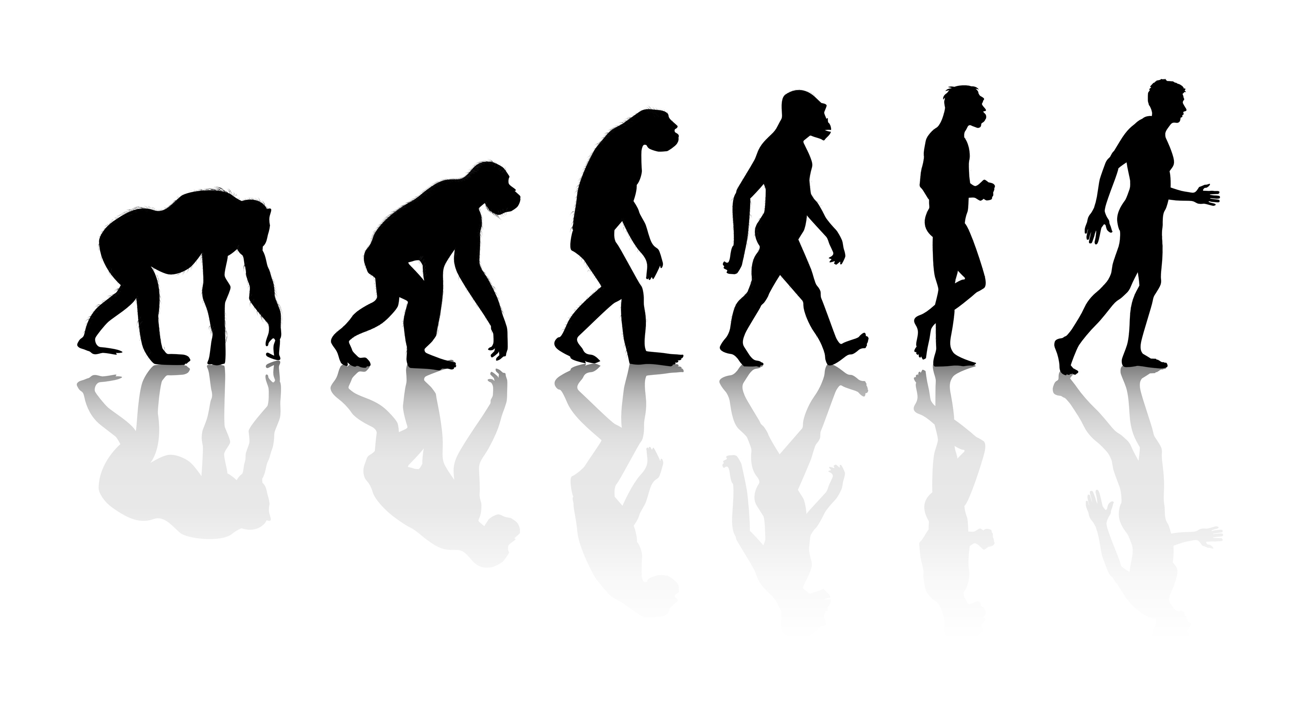

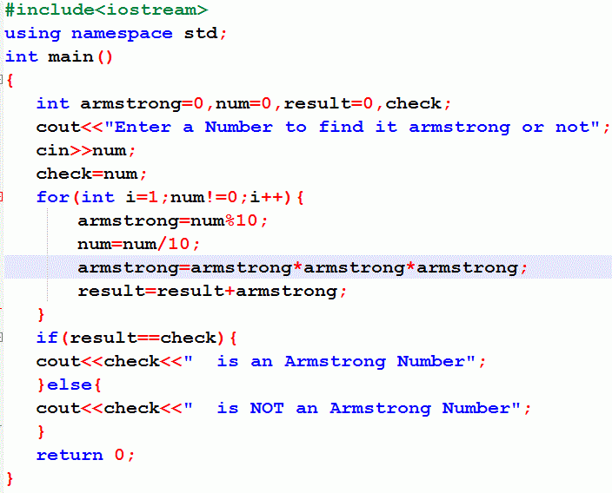
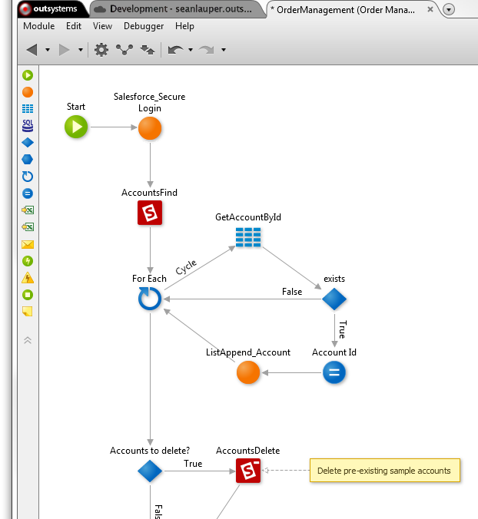
What is low code anyway?

Slide 4


Slide 5

App dev is hard

Slide 6




























Why is it so hard?
20-50
Apps
Multiple Platforms
And Form Factors
Abundance
of Integrations
Ever changing
technologies
X
X
X
X
Constant Change Requests and Application Updates

Slide 7
How do we fix this?

Slide 8
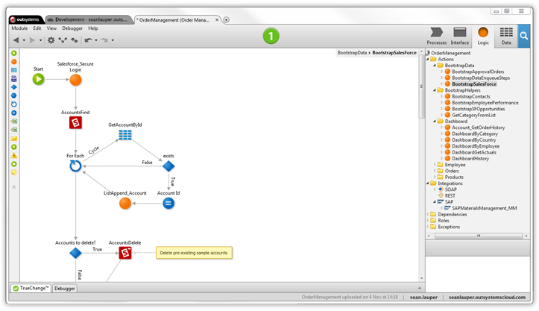
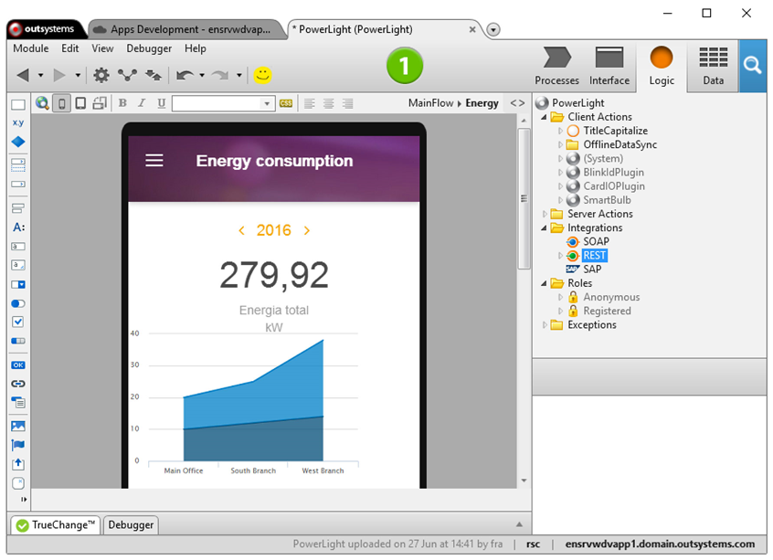
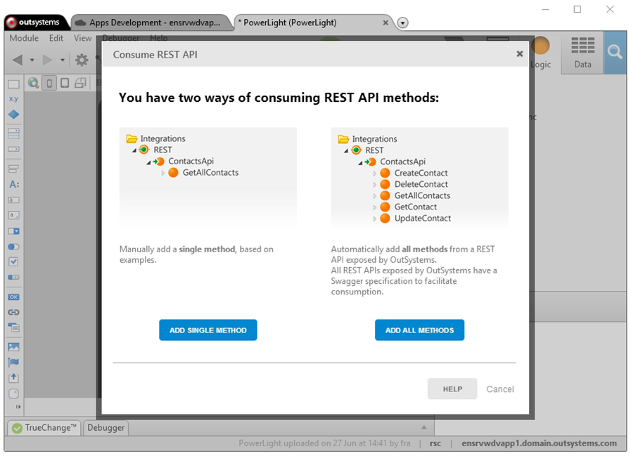
LOW CODE!!

Slide 9
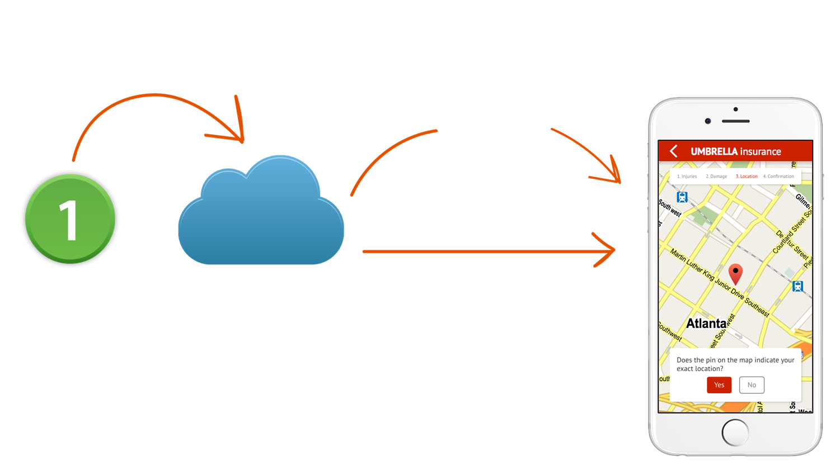
Automated release process

Slide 10
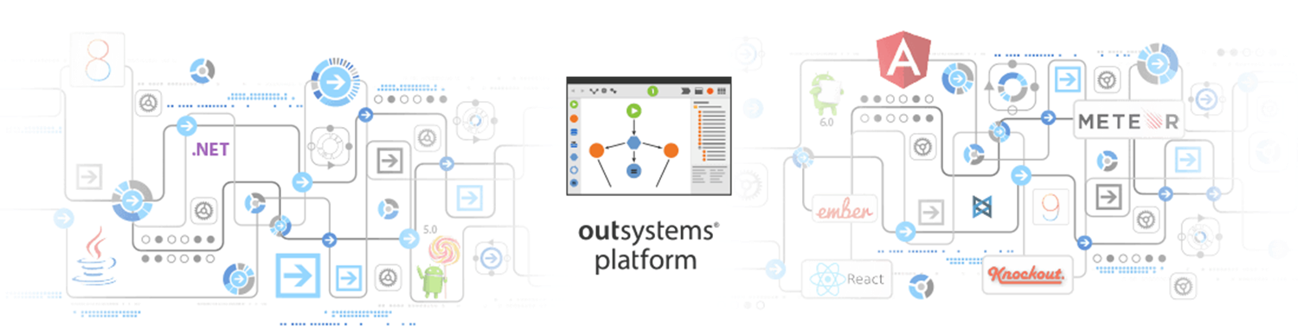

It’s all about getting things done

Slide 11
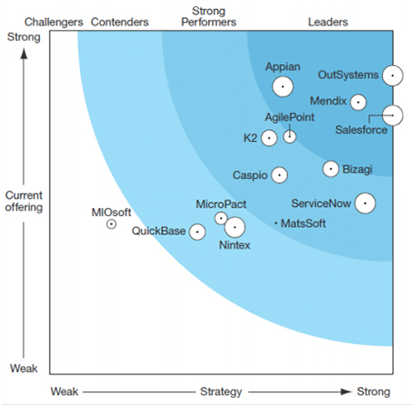












Hundreds of Enterprise Customers
Forrester Wave™ Low Code Report – Q2 2016

Slide 12
DEMO
Integrate to Reddit API
Integrate with Microsoft Cognitive API
Access device front camera
Deploy to device
Notes:
I was challenged by our Engineers to build an app with dogs and cats

Slide 13
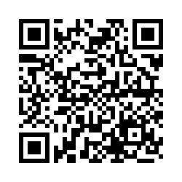
Too good to be true?
Try it for yourself and experience the awesome!
Sign-up for a personal environment with everything you need to create and deploy your apps, for free. www.outsystems.com
Fill out a post event survey and get a T-Shirt!!!
http://bit.ly/OutSystemsMeetup

